Slide 1

FPT University
Android programMing
Lesson 7
Version 1.0

Slide 2
Agenda
Animating User Interfaces with the Android Transitions Framework
Android Transition using beginDelayedTransition

Slide 3
Animating User Interfaces with the Android Transitions Framework
Introducing Android Transitions and Scenes - Transitions allow the changes made to the layout and appearance of the views in a user interface to be animated during application runtime
- The most powerful mechanism involves the transition is use of Scenes
- The actual animation is handled by the Transition framework via instances of the Transition class.

Slide 4
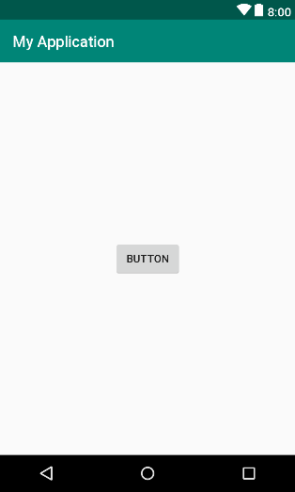
Animating User Interfaces with the Android Transitions Framework
Creating the Android Studio TransitionDemo Project

Slide 5
Animating User Interfaces with the Android Transitions Framework
Handle event
public void handleTouch() { Button button = (Button) findViewById(R.id.myButton); transition(button, ConstraintSet.BOTTOM); } public void onClick(View view){ Button button = (Button) view; transition(button, ConstraintSet.TOP); } void transition(Button button, int location){ TransitionManager.beginDelayedTransition(myLayout); ConstraintSet set = new ConstraintSet(); button.setMinimumWidth(500); button.setMinimumHeight(350); set.connect(R.id.myButton, location, ConstraintSet.PARENT_ID, location, 0); set.connect(R.id.myButton, ConstraintSet.RIGHT, ConstraintSet.PARENT_ID, ConstraintSet.RIGHT, 0); set.constrainWidth(R.id.myButton, ConstraintSet.WRAP_CONTENT); set.applyTo(myLayout); }

Slide 6
Animating User Interfaces with the Android Transitions Framework
Customizing the Transition
Transition changeBounds = new ChangeBounds(); changeBounds.setDuration(3000); changeBounds.setInterpolator(new BounceInterpolator()); TransitionManager.beginDelayedTransition(myLayout, changeBounds);

Slide 7
Animating User Interfaces with the Android Transitions Framework
Testing application

Slide 8
Transition Example
Working with Scene Transitions Scenes can be represented by the content of an Android Studio XML layout file
<RelativeLayout xmlns:android="http://schemas.android.com/apk/res/android" android:id="@+id/scene1" android:layout_width="match_parent" android:layout_height="match_parent" android:orientation="vertical" > <Button android:id="@+id/button1" android:layout_width="wrap_content" android:layout_height="wrap_content" android:layout_alignParentLeft="true" android:layout_alignParentTop="true" android:onClick="goToScene2" android:text="Button 1" /> ...... </RelativeLayout>

Slide 9
Transition Example
Create example project
Example project will working with two sences. Uses layout files and transition resource files to animate the transition from one scene to another within an application.

Slide 10
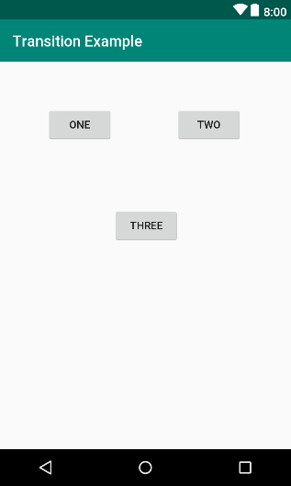
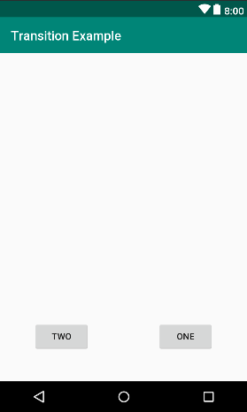
Transition Example
Design two scenes
Scene 1
Scene 2

Slide 11
Animating User Interfaces with the Android Transitions Framework
Loading scene to activity container
ViewGroup rootContainer; Scene scene1; Scene scene2; Transition transition; @Override protected void onCreate(Bundle savedInstanceState) { super.onCreate(savedInstanceState); setContentView(R.layout.activity_transition_demo); rootContainer = findViewById(R.id.rootContainer); transition = TransitionInflater.from(this) .inflateTransition(R.transition.transition); scene1 = Scene.getSceneForLayout(rootContainer, R.layout.scene1_layout, this); scene2 = Scene.getSceneForLayout(rootContainer, R.layout.scene2_layout, this); scene1.enter(); }

Slide 12
Animating User Interfaces with the Android Transitions Framework
Implementing the Transitions
public void goToScene2(View view){ TransitionManager.go(scene2); } public void goToScene1(View view){ TransitionManager.go(scene1); }

Slide 13
Animating User Interfaces with the Android Transitions Framework
Adding the Transition File
<?xml version="1.0" encoding="utf-8"?> <transitionSet xmlns:android="http://schemas.android.com/apk/res/android"> <changeBounds android:duration="2000"> </changeBounds> </transitionSet>

Slide 14
Animating User Interfaces with the Android Transitions Framework
Using transition set
public void goToScene2(View view){ TransitionManager.go(scene2, transition); }

Slide 15
Animating User Interfaces with the Android Transitions Framework
Using Interpolators with Transitions AccelerateDecelerateInterpolator
AccelerateInterpolator
AnticipateInterpolator
AnticipateOvershootInterpolator
BounceInterpolator
CycleInterpolator
DecelerateInterpolator.
LinearInterpolator
OvershootInterpolator

Slide 16
Animating User Interfaces with the Android Transitions Framework
<transitionSet xmlns:android="http://schemas.android.com/apk/res/android"> <changeBounds android:duration="2000" android:interpolator="@android:anim/anticipate_interpolator"> </changeBounds> </transitionSet>

Slide 17
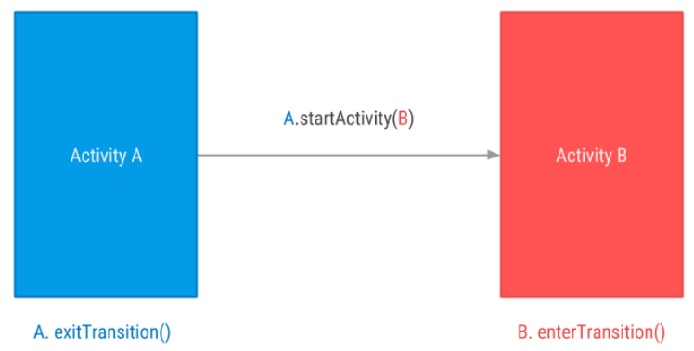
Activity Transition
Transitions between Activities
Animate existing activity layout content

Slide 18
Activity Transition
Android supports these enter and exit transitions:
explode - Moves views in or out from the center of the scene.
slide - Moves views in or out from one of the edges of the scene.
fade - Adds or removes a view from the scene by changing its opacity.

Slide 19
Activity Transition
Transition configuration
<?xml version="1.0" encoding="utf-8"?> <slide xmlns:android="http://schemas.android.com/apk/res/android" android:duration="1000"> <targets> <target android:excludeId="@android:id/statusBarBackground"/> <target android:excludeId="@android:id/navigationBarBackground"/> </targets> </slide>

Slide 20
Activity Transition
Behinde code for the transition
protected void onCreate(Bundle savedInstanceState) { super.onCreate(savedInstanceState); setContentView(R.layout.activity_main); setupSlideAnimations(); } private void setupSlideAnimations() { Slide slide = (Slide)TransitionInflater.from(this). inflateTransition(R.transition.activity_slide); slide.setSlideEdge(Gravity.LEFT); getWindow().setEnterTransition(slide); } public void onClick(View view) { Intent intent = new Intent(this, TransitionActivity.class); Bundle bundle = ActivityOptions.makeSceneTransitionAnimation(this).toBundle(); startActivity(intent, bundle); }

Slide 21
Activity Transition
Testing the application

Slide 22

End of Lesson 7

Slide 23
Thank you!

